Slide 1
5th annual meeting
PROGRAMME: WATER MANAGEMENT
Hellenic Ministry of Environment and Energy
“Executive Authority of the Partnership Agreement, Environmental sector”

Slide 2
GR- Water management
Output 1.1: Water management solutions implemented
Call 1.1 - Water management solutions implemented -desalination plants
4 proposals were selected for funding:
2 constructions of new desalination units
2 supplies and installations of new telemetry systems
3 projects are implemented with partners from Donor States
2 projects include bilateral relations actions
The Project Contracts were signed and these projects are under implementation
Call 1.1.02 - Water management solutions implemented -desalination plants
4 proposals were selected for funding
1 construction of new desalination unit
3 supplies and installations of new telemetry systems
Τhe Project Contracts will be signed soon after the relevant decision of the selection committee

Slide 3
GR- Water management
Output 1.2: Specific measures related to Greece’s Programme of Measures supported
Call 1.2 - Implementation of research measures of river basin management plans
3 proposals were selected for funding
All projects are research projects and implement research measures of river basin management plans
1 project is implemented with partner from Donor States
The Project Contracts were signed and these projects are under implementation

Slide 4
GR- Water management
Output 1.3: Knowledge of importance of water bodies with “Good Status” increased
Call 1.3 - Small Grant Scheme
1 proposal is selected for funding
The Hellenic Center for Marine Research (HCMR) will implement an information and awareness campaign on the islands of Santorini, Ios, Leros, Kalymnos, Pserimos and Telendos about the increasing of knowledge on the Importance of Good Status of Water Bodies
The project includes bilateral relations actions
The Project Contract is signed and this project is under implementation

Slide 6
OUTCOME INDICATORS
Indicator | Target value Programme | Total value from funded projects
 |  | Call 1.1 | Call 1.1.2 | Call 1.2 | Total
Number of water bodies with improved environmental status | 3 | 4 | 6 | 3 | 13
Number of beneficiaries of services provided or improved | 15,000 | 24,482 | 61,846 | - | 86,328
Estimated savings in EUR per year | 400,000 | 333,800 | 903,000 | - | 1,236,800
Estimated amount of water saved per year (in m³) | 500,000 | 760,000 | 2,200,000 | - | 2,960,000
Number of innovative green technologies/processes/solutions applied | 5 | 7 | 5 | - | 12

Slide 7
OUTPUT 1.1 INDICATORS Water management solutions implemented
Indicator | Target value Programme | Total value from funded projects
 |  | Call 1.1 | Call 1.1.2 | Total
Additional water production capacity installed per day (in m³) | 1,000 | 424 | 600 | 1,024
Installed capacity for production of renewable energy (in MW) | 0.10 | 0.17 | 0.01 | 0.18
Number of projects on improved brine disposal solutions | 1 | 1 | 1 | 2
OUTPUT 1.2 INDICATORS Specific measures related to Greece’s Programme of Measures supported
 |  | Call 1.2
Number of supported measures | 2 | 8
Number of research studies for “Good status” of water bodies carried out | 2 | 3

Slide 8
OUTPUT 1.3 INDICATORS Knowledge of importance of water bodies with “Good Status” increased
Indicator | Target value Programme | Total value from funded projects
 |  | Call 1.3
Number of awareness raising campaigns carried out | 1 | 1
Number of people reached by awareness campaigns | 1.000 | 18.000
Guidelines for water saving developed | YES | YES
BILATERAL INDICATORS Cooperation with a donor project partner
 |  | Projects are implemented with partners from Donor States | Projects include bilateral relations actions
Number of projects involving cooperation with a donor project partner | 4 | 4 | 4

Slide 9
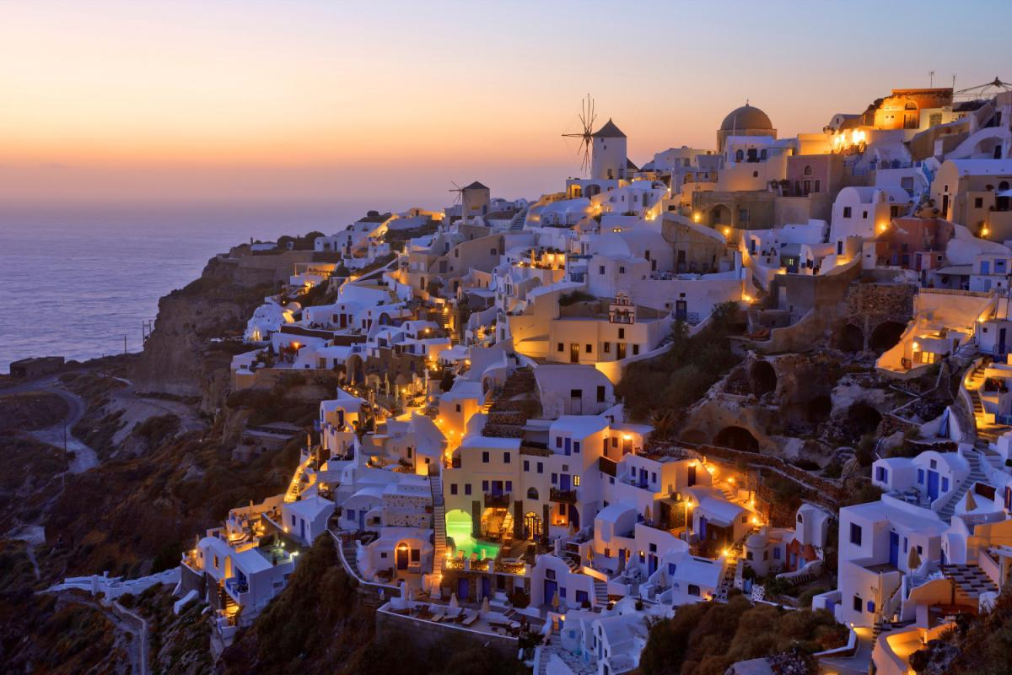
http://www.eysped.gr/el/Pages/EEA2014-2021.aspx eysped@mou.gr
Thank you!

